Slide 1
SQL 2.2

Slide 2
Learning Outcomes
By the end of this session, you will be able to:
Effortless Date Handling: Retrieve current dates and perform date arithmetic with SQL functions like DATE() and strftime().
Conditional Logic Mastery: Understand CASE statements for creating new data based on defined conditions.
Database Control: Execute essential operations like database and table creation, alteration, and deletion.
Data Manipulation and Querying Skills: Acquire proficiency in inserting, deleting, and querying data in SQL databases.
Understanding Relationships: Grasp Primary and Foreign Keys' significance in managing data relationships.
Exploration with Joins: Comprehend INNER JOIN and LEFT OUTER JOIN for merging data from multiple tables.

Slide 3
Working with Date Data
The date() function in SQL retrieves the current date. It's used to display the present date in SQL queries.
Syntax: SELECT date();

Slide 4


Working with Date Data
SELECT DATE();
SELECT date() AS current_date;

Slide 5

Working with Date Data
SELECT datetime() AS dateTimeNow;

Slide 6
Working with Date Data
Date manipulation in SQL involves commands to modify dates by adding or subtracting days, months, or years.
It aids in temporal analysis and dataset adjustments for precise date-based computations in data science.

Slide 7
Subtracting Time Periods
To subtract a day, month, or year from a given date, you can use:
SELECT DATE('2018-11-01','-1 day');
SELECT DATE('2018-11-01','-1 month');
SELECT DATE('2018-11-01','-1 year');

Slide 8
Adding Time Periods
To add a day, month, or year to a given date, use:
SELECT DATE('2018-11-01','+1 day');
SELECT DATE('2018-11-01','+1 month');
SELECT DATE('2018-11-01','+1 year');

Slide 9
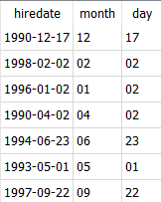
Activity
In the table employees of employee.db database, display the hired date along with the month and date.
SELECT hiredate, strftime("%m", hiredate) AS month, strftime("%d", hiredate) AS day FROM employees;
Note: Before this we need to update delimiter of dates
UPDATE employees SET hiredate = SUBSTR(hiredate, 7, 4) || '-' || SUBSTR(hiredate, 1, 2) || '-' || SUBSTR(hiredate, 4, 2);

Slide 10
CASE Statement
The CASE statement in SQL allows conditional logic to create new columns based on specific criteria within existing data.
For instance, when analyzing a sales dataset, you might want to categorize sales figures into 'High,' 'Medium,' or 'Low' based on predefined thresholds. The CASE statement facilitates this categorization.
Syntax: The basic syntax for the CASE statement is as follows:
SELECT *,
CASE
WHEN condition_1 THEN result_1
WHEN condition_2 THEN result_2
ELSE default_result
END AS new_column_name
FROM table_name;

Slide 11
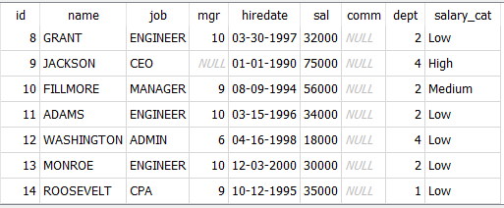
CASE Statement
SELECT *, CASE
WHEN sal > 60000 THEN "High"
WHEN sal > 40000 THEN "Medium"
ELSE 'Low'
END AS salary_cat
FROM employees;
The above code will create a new column called bins which will have values of high, medium, and low.

Slide 12
Creating a Database and Tables
Let’s create our own database.
Syntax: CREATE DATABASE database_name;
Example: An example is given below, in which a database named Analysis is created:
CREATE DATABASE Analysis;
Note: In tools like db-browser, a graphical interface allows database creation without the need for running SQL commands directly.

Slide 13
Quiz
How do you create a database named academics?
CREATE DATABASE academics;
CREATE db academics;

Slide 14
Creating Tables
Once we know how to create a database, the next step is to start creating tables in a database. In order to create tables, the first thing we need to do is to define the structure of the table.
To do that we will use the command called CREATE TABLE. Below is the general syntax of the command.
CREATE TABLE table_name (
column1 datatype,
column2 datatype,
column3 datatype );

Slide 15
Storage Classes and Data Types in SQLite
Each value stored in an SQLite database (or manipulated by the database engine) has one of the following storage classes:
NULL: Represents a NULL value.
INTEGER: Stores signed integers in varying byte sizes (0, 1, 2, 3, 4, 6, or 8) based on the value's magnitude.
REAL: Represents floating-point values stored as 8-byte IEEE floating point numbers.
TEXT: Stores text strings utilizing the database encoding (UTF-8, UTF-16BE, or UTF-16LE).
BLOB: Represents data stored precisely as entered, functioning as a blob of data.

Slide 16
Activity
In your SQLite DB-Browser, create a Student table in academics with following attributes:
student_id: This will contain the number data and the student ID of a student.
first_name: This will contain text data and a student's first name.
last_name: This will again contain text data and the last name of a student.

Slide 17
Activity
In your SQLite DB-Browser, create a Student table in academics with following attributes:
student_id: This will contain the number data and the student ID of a student.
first_name: This will contain text data and a student's first name.
last_name: This will again contain text data and the last name of a student.
CREATE TABLE student (
Student_Id INTEGER,
First_Name VARCHAR(50),
Last_Name VARCHAR(50)
);

Slide 18
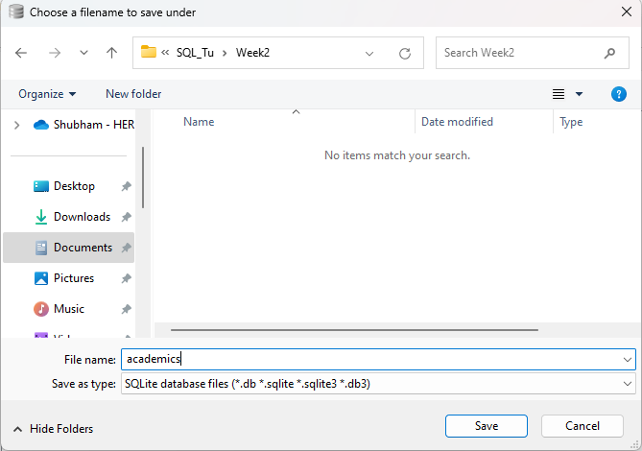
Activity

Slide 19
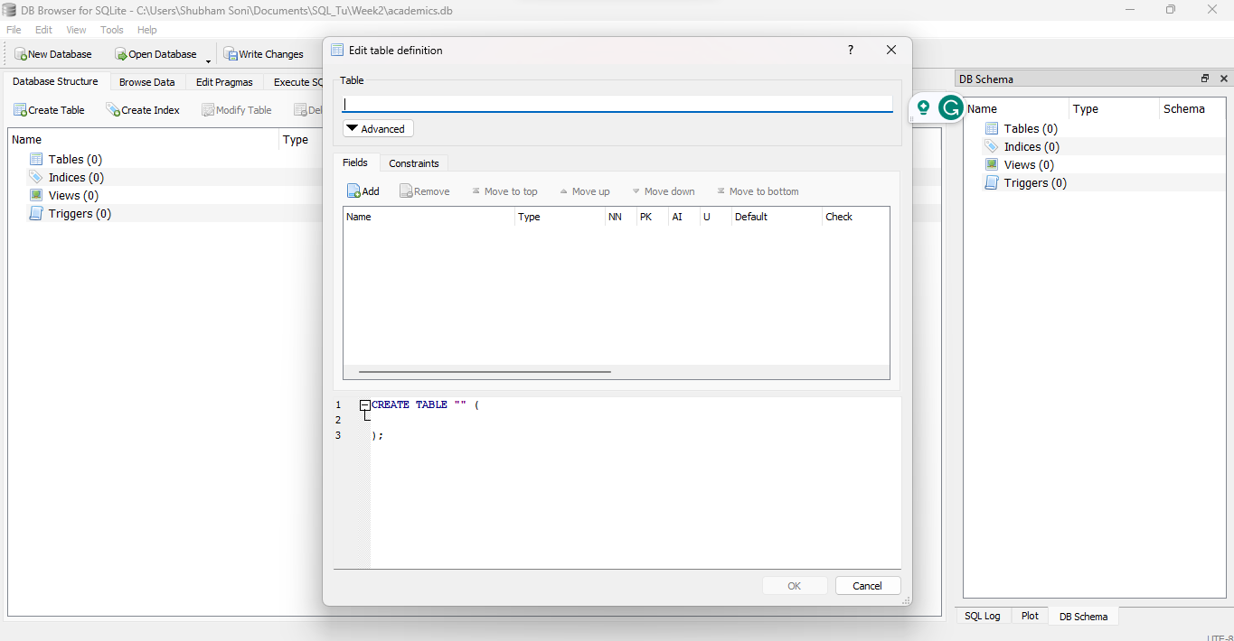
Activity

Slide 20
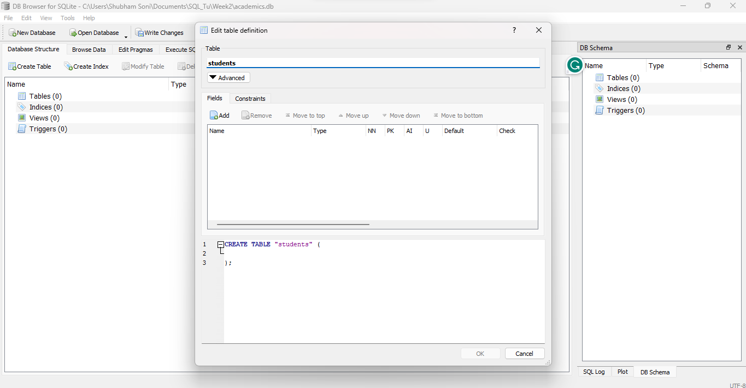
Activity

Slide 21
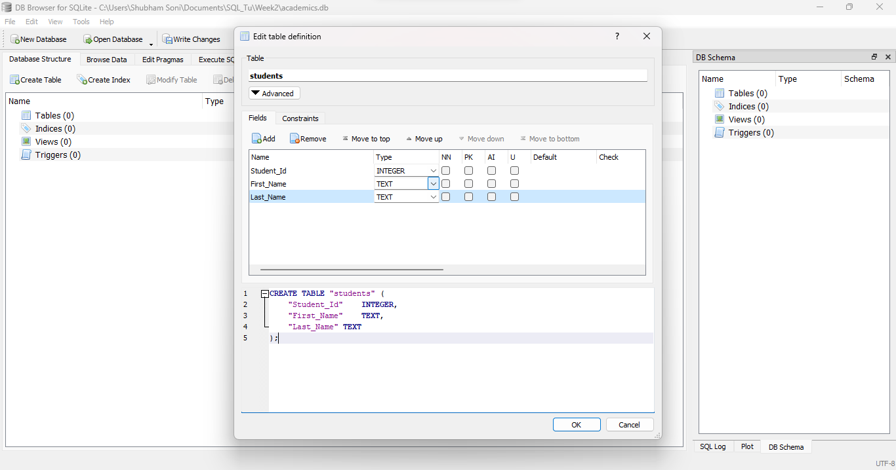
Activity

Slide 22
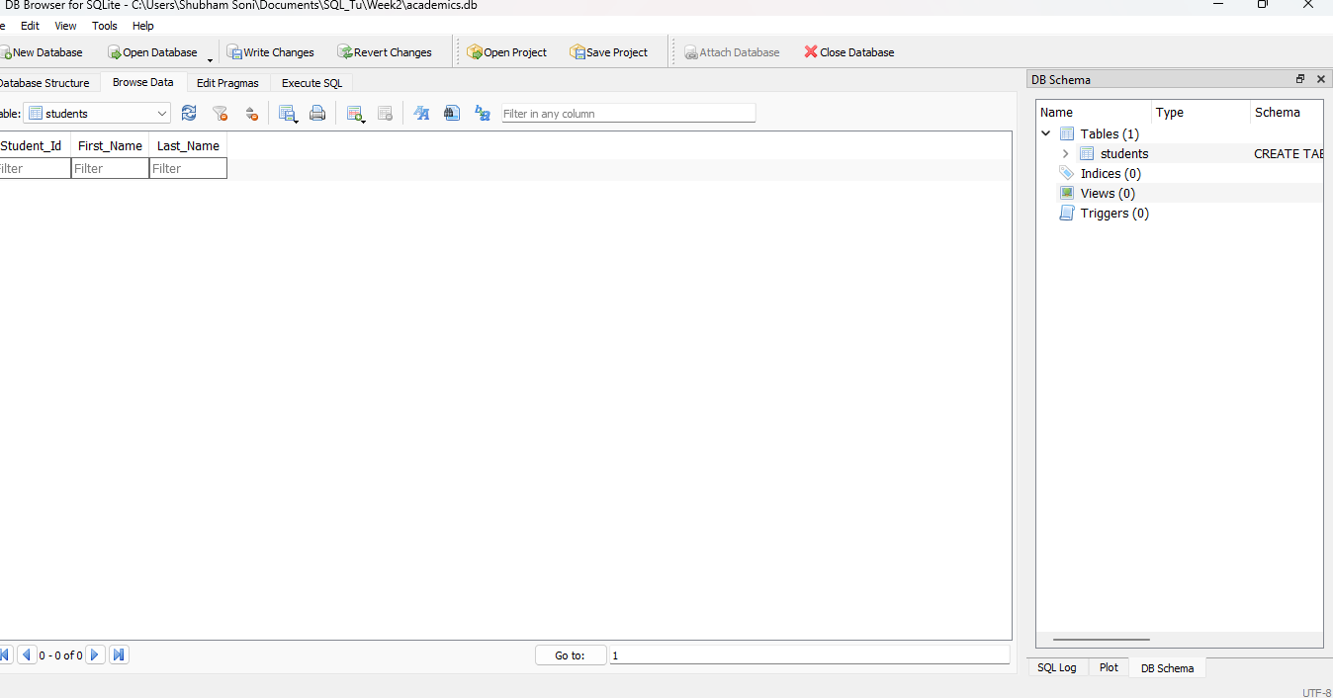
Activity

Slide 23
Inserting Data into Tables
The INSERT INTO statement is pivotal for adding new records to a table, offering two approaches to insert data:
Specifying Column Names and Values:
Direct Insert Without Specifying Column Names:
INSERT INTO table_name (column1, column2,...) VALUES (value1, value2,...);
INSERT INTO table_name VALUES (value1, value2,...);
Note: In the second method, you can add data directly into all columns without mentioning their names.

Slide 24
Inserting Data into Tables
How to insert data?

Slide 25
Inserting Data into Tables
First Approach:
Second Approach:
INSERT INTO students (Student_Id, First_Name, Last_Name ) VALUES (1, 'Leo', 'Saut');
INSERT INTO students VALUES (2, 'Sam', 'Stuart');

Slide 26
Inserting Data into Tables
Filling in multiple rows within a single query.
INSERT INTO student VALUES (3, 'Sam', 'Stuart'), (4, 'Tom', 'Little');

Slide 27
Quiz
How do you add a row to the table ‘students’ with 2 text columns of First_name and Last_name?
INSERT INTO students Student_Id, First_Name) VALUES (‘Ram’,’Sharma’);
INSERT INTO students VALUES (‘Ram’,’Sharma’);
INSERT students VALUES (‘Ram’,’Sharma’);

Slide 28
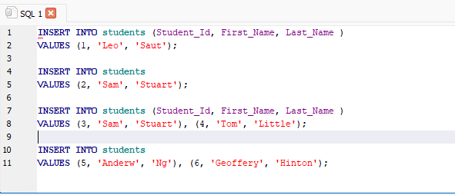
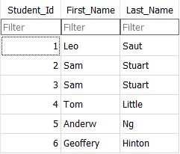
Inserting Data into Tables

Slide 29
SQL Command Groups
Data Query Language (DQL) statement
Data Definition Language (DDL) statements
Data Manipulation Language (DML) statements

Slide 30
Data Query Language (DQL) statement
The SELECT statement is used to access data contained in a table.
The returned data is saved in a result table referred to as the result-set.
Syntax:
SELECT col1, col2, … FROM table_name;
Note: In the previous session, we exclusively covered DQL (Data Query Language) statements, focusing on data querying techniques.

Slide 31
Data Definition Language (DDL) statements
These statements are responsible for defining and managing the structure of the database.
DDL statements like CREATE, ALTER, DROP and DELETE FROM students;
are used to create, modify, or delete database objects like tables.

Slide 32
CREATE Statement
Generates new database objects.
Syntax:
CREATE TABLE table_name (
column1 datatype,
column2 datatype,
...
);

Slide 33
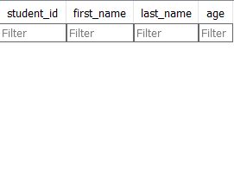
CREATE Statement
Example:
CREATE TABLE students (
student_id INTEGER PRIMARY KEY,
first_name TEXT NOT NULL,
last_name TEXT NOT NULL,
age INTEGER
);

Slide 34
ALTER Statement
Modifies existing database objects.
Syntax:
ALTER TABLE table_name ADD column_name datatype;

Slide 35
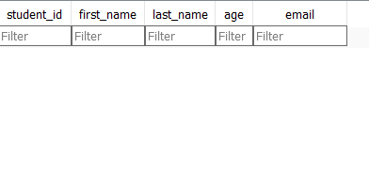
ALTER Statement
Example:
ALTER TABLE students ADD email TEXT;

Slide 36
DROP Statement
Syntax:
Example
DROP TABLE table_name;
DROP TABLE students;

Slide 37
DELETE Statement
Removes all data from a table.
Syntax
Example
DELETE TABLE table_name;
DELETE FROM students;
Note:
This content provides an overview of DDL, its key statements (CREATE, ALTER, DROP ,DELETE), their syntax, and illustrative code examples.
The SQL statement "TRUNCATE TABLE students;" is a valid command in most database management systems (DBMS). It is used to remove all rows from the "students" table, effectively deleting all the data while keeping the table structure intact.

Slide 38
Data Manipulation Language (DML) Statements
DML statements are used for manipulating data within the database.
DML commands (INSERT, UPDATE, DELETE) manage the data stored in tables, allowing for the insertion, modification, or deletion of records, thereby manipulating the database content.

Slide 39
Data Manipulation Language (DML) Statements
Key DML Statements:
INSERT
UPDATE
DELETE

Slide 40
INSERT Statement
Adds new records into a table.
Syntax:
Example
INSERT INTO table_name (col1, col2, ...) VALUES (value1, value2, ...);
INSERT INTO students (first_name, last_name, age) VALUES ('John', 'Doe', 25);

Slide 41

UPDATE Statement
Modifies existing records in a table.
Syntax:
Example
UPDATE table_name SET column1 = value1, column2 = value2, ... WHERE condition;
UPDATE students SET age = 26 WHERE first_name = 'John';

Slide 42
DELETE Statement
Removes records from a table based on a specific condition.
Syntax
Example
DELETE FROM table_name WHERE condition;
DELETE FROM students WHERE age > 30;

Slide 43
Understanding Relationships in Data
One-to-One Relationship in Databases
A "one-to-one relationship" occurs when the primary key of one table matches the foreign key of another table.
This connection establishes a direct and singular correspondence between the two tables.

Slide 44
Understanding Relationships in Data
Example
Imagine you have a table that contains employee information and another table that contains the salary account details. Now, each employee will have only one salary account. In this case, there is a one-to-one relationship between employees and their bank account.
Employee
Emp_id
Name
Designation
Department
Salary_Account
Id
Emp_id
Date
Transaction
1
1

Slide 45
Describe Types of Relationships in Data
What is a Primary Key ?
Ensures the data in a specific column is unique.
What is a Foreign Key
Column or a group of columns in a relational database table that provides a link between data in two tables

Slide 46
Artists
ArtistID
ArtistName
ArtistBiography
ArtistPicture
Recording
AlbumID
ArtistID
GenreID
YearOfRelease
NumberOfTracks
Price
AlbumCover
Primary Key
Foreign Key

Slide 47
What Are Constraints?
Constraints are rules imposed on a table's data columns to ensure stored information remains meaningful and pertinent.
Constraints
Are the rules enforced on a data column in a table to store meaningful and relevant data?
Can be applied at the column or table level.
At the column level are applied to a single column, whereas constraints at the table level are applied to the entire table.

Slide 48
Types of Constraints
Following are commonly used constraints available in SQLite:
NOT NULL Constraint − Ensures that a column cannot have NULL value.
DEFAULT Constraint − Provides a default value for a column when none is specified.
UNIQUE Constraint − Ensures that all values in a column are different.
PRIMARY Key − Uniquely identifies each row/record in a database table.
CHECK Constraint − Ensures that all values in a column satisfies certain conditions.
FOREIGN Constraint-SQL foreign key constraints are used to enforce "exists" relationships between tables.

Slide 49
What Are JOINS?
Joins combine rows from multiple tables by linking them through a shared column.
Types of Joins
Inner Join
Left Outer Join
Cross Union

Slide 50
What is an INNER JOIN ?
An INNER JOIN selects all rows from both tables when there is a match between the columns.
A
B

Slide 51
INNER JOIN
Syntax
SELECT column_name(s) FROM table1
INNER JOIN table2 ON table1.column_name = table2.column_name;
This SQL syntax combines rows from 'table1' and 'table2' based on the matching condition specified after the INNER JOIN keyword using the ON clause.
Adjust 'column_name' to the specific columns you want to use for matching in both tables

Slide 52
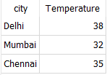
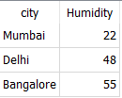
Example
Let say we two table:
Temperature
Humidity

Slide 53

Example
SELECT * FROM Temperature T
INNER JOIN Humidity H
ON T.city = H.city;
OR
SELECT * FROM Temperature T
JOIN Humidity H
ON T.city = H.city;

Slide 54

Example
SELECT T.city, T.temperature, H.humidity FROM Temperature T
INNER JOIN Humidity H
ON T.city = H.city;

Slide 55
What is a LEFT OUTER JOIN?
A LEFT OUTER JOIN returns all records from the left table and the matching records from the right table.
A
B

Slide 56
LEFT OUTER JOIN
Syntax
SELECT column_name(s)
FROM table1
LEFT JOIN table2 ON table1.column_name = table2.column_name;

Slide 57
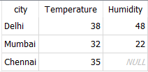
Example
SELECT t.city, t.Temperature, h.Humidity FROM Temperature T
LEFT JOIN Humidity H
ON T.city = H.city;

Slide 58
Summary
Expanding our SQL journey, we honed essential skills for adept data management and analysis. We began with mastering date functions for efficient date handling and applied conditional logic through CASE statements for dynamic data creation based on specific conditions.
Further, we delved into comprehensive database control, covering operations like data manipulation, querying, and understanding data relationships, including Primary and Foreign Keys.
Additionally, we explored join operations, dissecting INNER JOIN and LEFT OUTER JOIN for seamless data integration across tables.

Slide 59
Thank You!

